Slide 1
Data analytics internship
Analysing Yelp dataset
Month 1
Intern: Edna Fazlagić
Mentor: Mehmed Kadrić

Slide 2
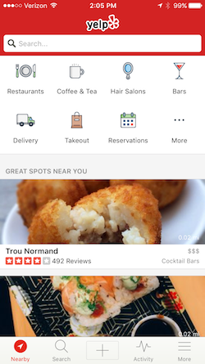
What is Yelp.com?
Local business review and social networking site
According to the 2018 Online Reviews Survey by ReviewTrackers, approximately 45 percent of consumers say they are likely to check reviews on Yelp before visiting a business
Second to Google

Slide 3
Yelp dataset
Business.json
User.json
Review.json
Tip.json
Photo.json
Check.in

Slide 4
Business
192609 rows
Dataset containes information about each business, name, address, city, state, postal code, latitude, longitude, stars, review count, business id, is open attribute, hours and attributes
Json flattening
.json to .csv

Slide 5
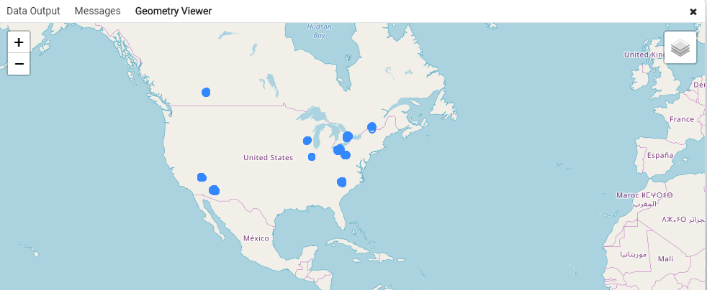
Business

Slide 6
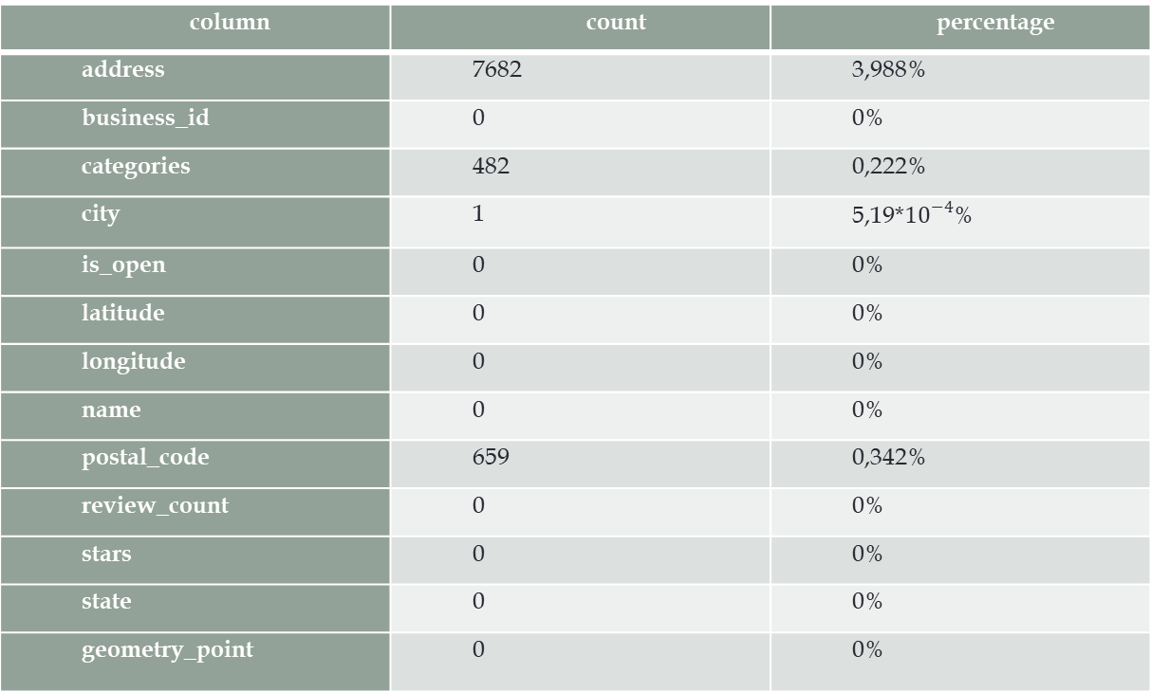
Basic analysis – missing values
column | count | percentage
address | 7682 | 3,988%
business_id | 0 | 0%
categories | 482 | 0,222%
city | 1 | 5,19*${10}^{−4}$%
is_open | 0 | 0%
latitude | 0 | 0%
longitude | 0 | 0%
name | 0 | 0%
postal_code | 659 | 0,342%
review_count | 0 | 0%
stars | 0 | 0%
state | 0 | 0%
geometry_point | 0 | 0%

Slide 7
Basic analysis – completeness
column | percentage
address | 96%
business_id | 100%
categories | 99,75%
city | 99.999%
is_open | 100%
latitude | 100%
longitude | 100%
name | 100%
postal_code | 99,65%
review_count | 100%
stars | 100%
state | 100%
geometry_point | 100%

Slide 8
Basic analysis – dummy values
city | state
Down | DOW
Bath | BAS
Sale | XGM
London | XGL
Manchester | XGM
Church Cove | CON
Oldham | XGM
Bury | XGM
Leeds | XWY
Thornhill | DUR
Leeds | XWY

Slide 9
Basic analysis – frequency
column | frequency
address | 151976
business_id | 192609
categories | 93385
city | 1203
is_open | 2
latitude | 155162
longitude | 150404
name | 145046
postal_code | 17540
review_count | 1184
stars | 9
state | 36
geometry_point | 157776
Unique values
distributed by columns:

Slide 10
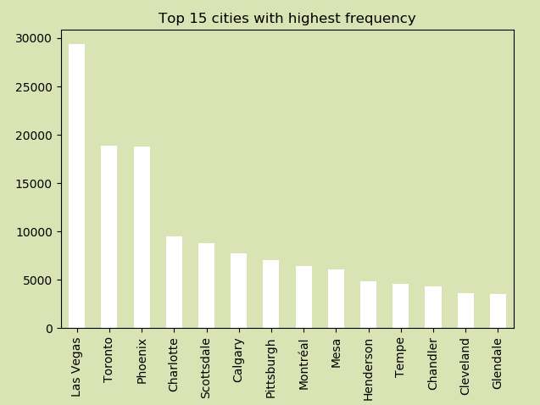
Basic analysis – frequency

Slide 11
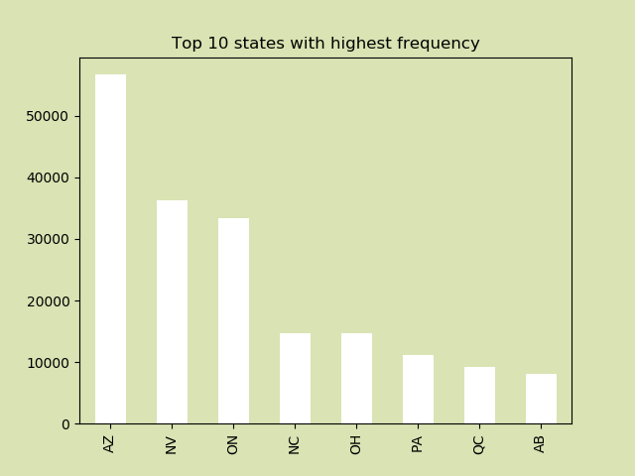
Basic analysis – frequency

Slide 12
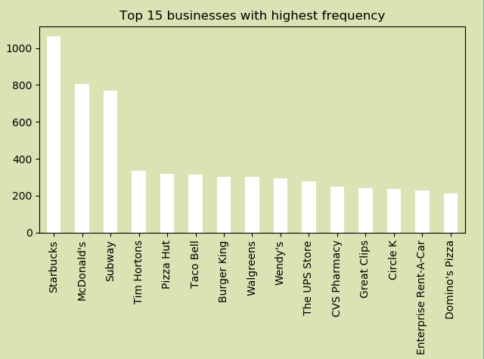
Basic analysis – frequency

Slide 13
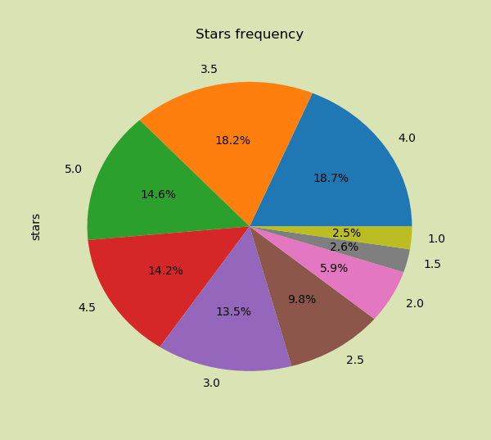
Basic analysis – frequency

Slide 14
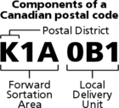
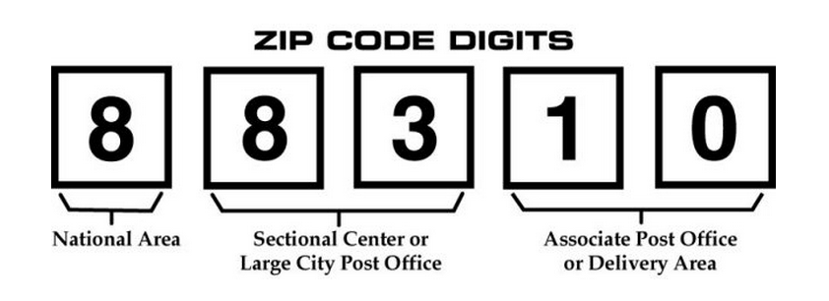
Suspicious or invalid patterns
Invalid postal code format
1839 Canadian postal codes in the
dataset that are missing local delivery
unit code

Slide 15
Suspicious or invalid patterns
 | city | state | postal_code
1. | Brossard | QC | J4W 1
2. | Toronto | ON | M5V 1MB
3. | Bath | BAS | BA1 1NG
4. | Sale | XGM | M33 7XW
5. | Bury | XGM | BL8 4DR
6. | Manchester | XGM | M12 5GH
7. | Calgary | AB | T3J 0HB
8. | Thornhill | ON | L4J 4PJ
9. | Leeds | XWY | LS6 4EP
10. | Toronto | ON | M6K 3JI
11. | Toronto | ON | M6G 1LM
12. | Calgary | AB | t2g 3m5
13. | Toronto | ON | m2k 0c5
14. | Markham | ON | L3R 1
15. | Toronto | ON | M6H 3
16. | Oldham | XGM | OL2 6PX
17. | Calgary | AB | T2E 6
18. | Mississauga | ON | L5L 3RI
19. | Toronto | ON | M5B 1NB
20. | Toronto | ON | M6H 2BH

Slide 16
Suspicious or invalid patterns
3194 unstandardized
address format
888 records with no
street number
name | address
The UPS Store | Credit Valley Town Plaza, F2 - 6045 Creditview Rd
Marathon Diner | Center Core - Food Court, Fl 3, Pittsburgh International Airport
Gap | Northlake Mall, 6801 Northlake Mall Drive
Artisan Fine Dining Room | Artisan Hotel, 1501 W Sahara Ave
Carolina Beer Company | Charlotte-Douglas Intl Airport
Bar Charlie | The Palazzo Hotel, 3325 Las Vegas Blvd S
Mortgages.ca | Unit 305, 145 Front Street E
The Laser's Edge | #103, 1608 17 Ave SW
T&T Roti Trinidad & Toronto Roti | Market 707
Ermenegildo Zegna | Crystals At CityCenter

Slide 17
Suspicious or invalid patterns
Las Vegas
AZ | 1
CA | 2
FL | 1
GA | 1
NC | 1
NE | 1
NM | 1
NV | 29361
TX | 1
(total 29370)
Toronto
state | count
AB | 1
OH | 1
ON | 18904
(total 18906)
Phoenix
state | count
AZ | 18764
TX | 2
(total 18766)
Charlotte
state | count
NC | 9507
SC | 2
(total 9509)
Chandler
state | count
AL | 1
AZ | 4307
CA | 1
(total 4309)
Calgary
state | count
AB | 7735
AL | 1
(total7736)

Slide 18
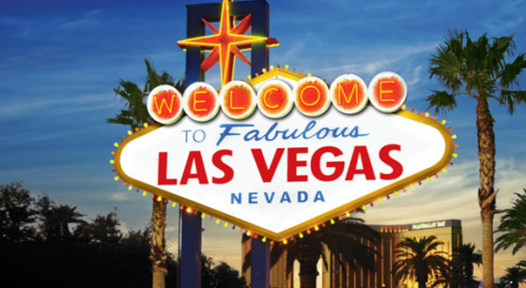
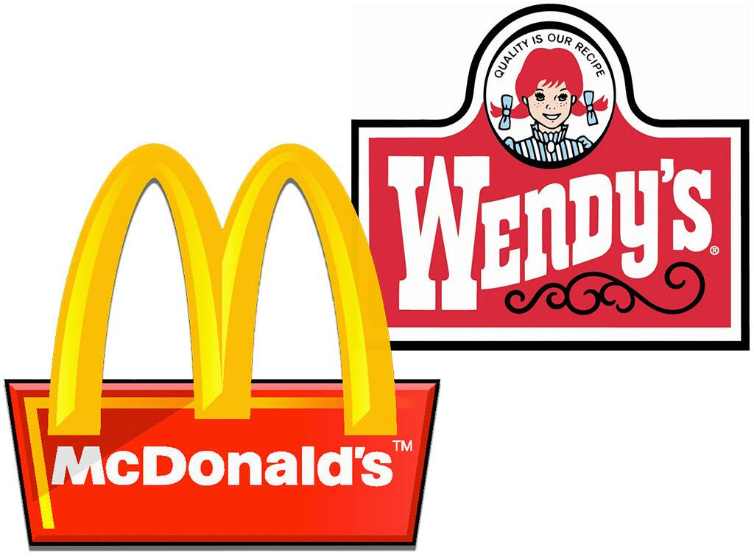


Unstandardized data
Business name
City name

Slide 19
Unstandardized data – business name
name | count
Pizza Hut | 320
Pizza Hut Express | 2
Pizza Hut Inside Target | 1
name | count
McDonald | 1
Mcdonald's | 3
McDonald's | 805
McDonald's - MGM Grand The District Food Court | 1
Mcdonalds | 5
McDonalds | 22
name | count
Tim Horton | 7
Tim Horton's | 61
Tim Horton's - University Of Calgary | 1
Tim Horton Donuts | 4
Tim hortons | 1
Tim Hortons | 333
Tim Hortons Cafe & Bake Shop | 1
name | count
Subway | 768
Subway Mahogany | 1
Subway sandwich shop | 1
name | count
Starbucks | 1066
Starbucks Coffee | 6
Starbucks Reserve | 1

Slide 20
Unstandardized data – business name
name | count
Cvs | 1
CVS | 1
Cvs 1742 | 1
Cvs 2772 | 1
CVS Caremark | 1
Cvs Front Store | 1
CVS Minute Clinic | 1
Cvs Pharmacy | 9
CVS Pharmacy | 250
Cvs Store | 1
Cvs Store 2877 | 1
Cvs/Pharmacy | 1
name | count
Kentucky Fried Chicken & Taco Bell | 1
Taco bell | 1
Taco Bell | 313
Taco Bell Cantina | 3
Taco Bell of Canada | 2
name | count
Health Care Clinic At Walgreens | 1
Walgreen's | 1
Walgreens | 301
Walgreens Mail Service Pharmacy | 1
Walgreens Pharmacy | 1
name | count
Burger King | 302
BURGER KING | 1
Burger King | 1
Burger King Canada | 2
Burger King Restaurant | 7
Burger King Restaurants | 4
Burger King Unit 4232 | 1
name | count
Wendy's | 294
Wendy's Noodle Cafe | 1
Wendy's Old Fashioned Hamburgers | 2
Wendy's Restaurant | 1
Wendy's Richmond Hill | 1
Wendys | 4

Slide 21
Unstandardized data – business name
name | count
Great Clip For Hair | 1
Great Clips | 240
Great Clips - Anderson Springs | 1
Great Clips - Camelback Colonnade | 1
Great Clips - Fry's Sundome Plaza | 1
Great Clips - Odana | 1
Great Clips Hair Salon | 1
name | count
Domino's | 35
Domino's Pizza | 210
Domino Foods | 1
Dominos | 3
Dominos' Pizza | 1
Dominos Pizza | 3
name | count
7-Eleven | 178
7-Eleven Bar | 1
7 Eleven | 1
name | count
Enterprise Motorcycle Rental | 1
Enterprise Rent-A-Car | 227
Enterprise Rent-A-Truck | 1
Enterprise Rent a Car | 1
Enterprise Truck Rental | 1
name | count
Baskin Robbins & Dunkin' Donuts | 1
Dunkin' Donuts | 187
Dunkin' Donuts & Baskin-Robbins | 1
Dunkin' Donuts (Canada) Ltee | 1
Dunkin' Donuts/Baskin-Robbins | 1
Dunkin Donut | 2
Dunkin Donuts | 25
Dunkin Donuts Baskin Robbins | 1
Dunkin Donuts & Baskin Robbins | 5
Dunkin Donuts Baskin-Robbins | 1
Dunkin Donuts Baskin Robbins | 3
name | count
circle k | 1
Circle K | 238
Circle K Food | 1
Circle K Stores | 9
Shell - Circle K #6347 | 1

Slide 22
Unstandardized data – city name
city | count
110 Las Vegas | 1
C Las Vegas | 1
La Vegas | 2
Lake Las Vegas | 1
Las Vegas | 5
las vegas | 8
las Vegas | 1
Las vegas | 14
Las Vegas | 29370
LAS VEGAS | 19
Las Vegas | 4
Las Vegas East | 1
Las Vegas Valley | 1
Las Vegas, | 1
Las Vegass | 1
LasVegas | 2
Los Vegas | 1
South Las Vegas | 4
Vegas | 1
city | count
charlotte | 3
Charlotte | 9509
CHARLOTTE | 7
Charlotte | 2
North Charlotte | 1
South Charlotte | 1
city | count
North Scottsdale | 1
Old Scottsdale | 1
Old Town Scottsdale | 2
scottsdale | 5
Scottsdale | 8837
SCOTTSDALE | 3
Scottsdale, AZ | 1
Westworld Scottsdale | 1
city | count
Central Henderson | 1
henderson | 3
Henderson | 4892
HENDERSON | 8
Henderson (Green Valley) | 1
Henderson and Las vegas | 1
Henderson Nevada | 1
Las Vegas & Henderson | 1
W Henderson | 1

Slide 23
Unstandardized data – city name
city | count
calgary | 1
Calgary | 7736
CALGARY | 1
East Calgary | 1
Northeast Calgary | 1
Northwest Calgary | 3
Southeast Calgary | 3
SW Calgary | 1
city | count
Communauté-Urbaine-de-Montréal | 2
montreal | 1
Montreal | 153
Montréal | 6449
Montreal-Est | 1
Montréal-Est | 1
Montreal-Nord | 7
Montréal-Nord | 3
Montreal-Ouest | 4
Montréal-Ouest | 4
Montreal-Quest | 1
Montreal-West | 3
Montréal-West | 1
Montréal (Québec) | 1
Old Port of Montreal | 1
Vieux-Montréal | 1
West Montréal | 1
city | count
East Pittsburgh | 6
Pittsburch | 1
Pittsburg | 8
Pittsburgh | 7017
Pittsburgh | 2
St.Pittsburgh | 1

Slide 24
Unstandardized data – city name
city | count
Downtown Toronto | 4
North Toronto | 1
toronto | 3
Toronto | 18906
TORONTO | 2
Toronto-Etobicoke | 1
Toronto-North York | 1
Toronto-West | 1
Toronto Division | 1
Toronto Scarborough | 1
West Toronto | 1
city | count
Metro Phoenix | 1
North Phoenix | 1
phoenix | 9
Phoenix | 18766
PHOENIX | 6
Phoenix | 1
Phoenix AZ | 1
Phoenix Metro Area | 2
Phoenix Valley | 1
Phoenix, | 1
Phoenix, AZ | 2
city | count
East Mesa | 1
mesa | 3
Mesa | 6080
MESA | 6
Mesa Arizona | 1
Mesa AZ | 1

Slide 25
Stars on Yelp

Slide 26
High, medium and low quality data

